Slide 1

Bake My Cake - Online Cake web Application Pavan Kumar Padamata

Slide 2

Objective
Objective: To develop a user-friendly web application for ordering cakes online, offering a seamless experience for customers and efficient order management for the administrator
Bake My Cake

Slide 3

Intro Video

Slide 4
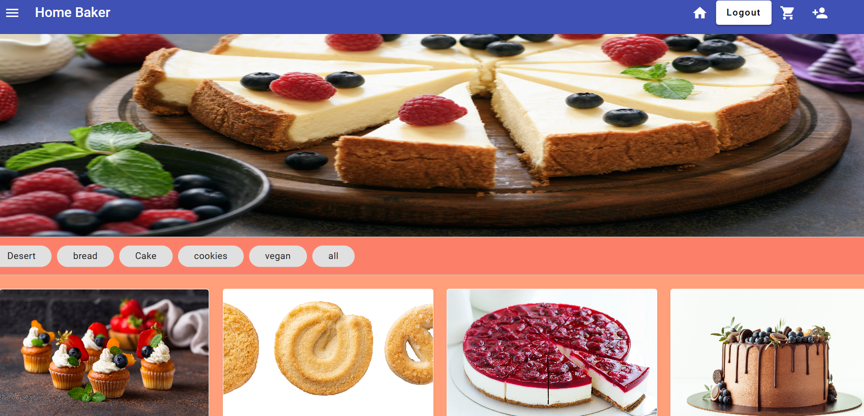
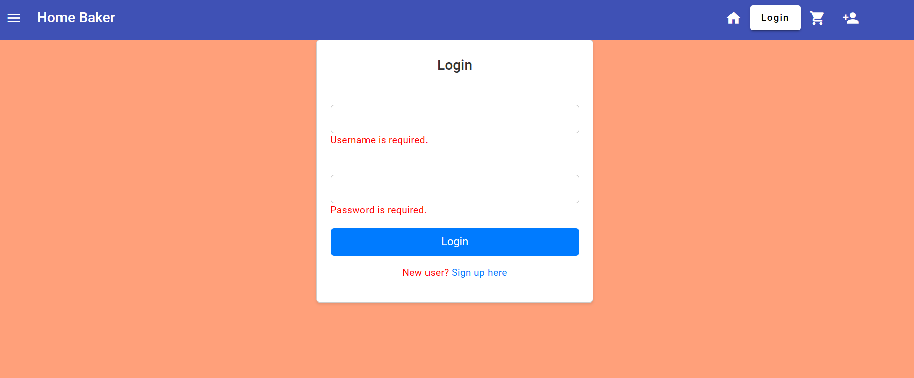
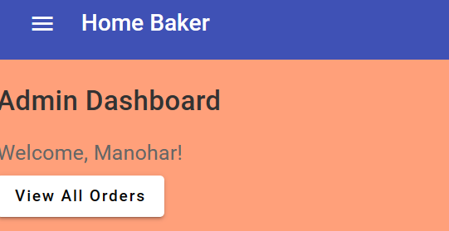
Features
User-Friendly Browsing
User Registration
Login
Product Catalog
Add to Cart
Cart Management
Order Placement
Order History
Administrator Access
User feeling satisfied after successfully logging in
Bake My Cake

Slide 5
More Features
An order confirmation page showing a happy user
Administrator's dashboard with order management tools
Bake My Cake

Slide 6





Technologies
Angular: Front-end development framework
JSON: Data format for data exchange
TypeScript: Programming language for building web applications
Authentication: Secure user registration and login using authentication libraries
Bake My Cake

Slide 7

Challenges
Data Security
User Authentication
Real-Time Updates
Payment Gateway Integration
Scalability
User Experience
JSON Data Loading
Bake My Cake

Slide 8
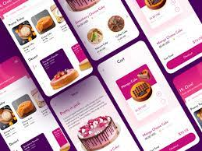



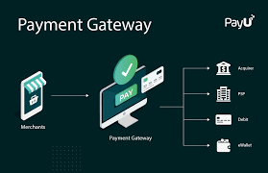
Future Enhancements
Mobile App
Discount Offers
Recommendation Engine
Feedback System
Advanced Payment Option
Advanced Analytics
Bake My Cake

Slide 9

Questions....
Bake My Cake

Slide 10

Conclusion
Conclude by emphasizing that Bake My Cake is a user-centric and efficient solution for online cake ordering, making it easy for users to explore, order, and enjoy delicious cakes
Bake My Cake

Slide 11

Bake My Cake

